Slide 1
Chapter 15 – Part I
Identifying Failure & Repair Distributions
Identifying Candidate Distributions
Probability Plots & Least-squares curve-fitting
Chapter 15
Notes:
This chapter along with Chapter 16 develops a methodology for fitting a theoretical probability distribution to a set of failure or repair data.

Slide 2
Fitting Theoretical Distributions
Empirical models do not provide information beyond the range of the sample data.
A sample is only a small (random) subset of the population of failure times, and it is the distribution the sample came from and not the sample itself which we want to establish.
Often the failure process is a result of some physical phenomena which can be associated with a particular distribution.
Small sample sizes provide very little information concerning the failure process. However, if the sample is consistent with a theoretical distribution, then much "stronger" results are possible based upon the properties of the theoretical distribution.
Use can be made of the theoretical reliability model in performing more complex analysis of the failure process.
Chapter 15
Notes:
Theoretical distributions would normally be preferred over an empirically derived reliability function for the reasons given here.

Slide 3
Identifying Candidate Distributions
3 - Step Process:
Identify candidate distributions
  Construct a histogram
  Compute descriptive stats
  Analyze empirical failure rate
  Use prior knowledge
  Use properties of theoretical distribution
  construct a probability plot
Estimate parameters (Maximum Likelihood)
Perform a goodness-of-fit tests (Chapter 16)
Chapter 15
Notes:
A sound methodology is to use descriptive statistics to identify a candidate distribution, estimate the parameters of the candidate, and then perform a goodness-of-fit test to statistically accept or reject the candidate.

Slide 4
Histograms
Sturges’ rule for grouping data
k = 1 + 3.3 log₁₀ n
where k = number of classes,
n = sample size.
x = integer part of x
For example,
n k
50 7
500 10
5000 13
Chapter 15
Notes:
One of the first steps in identifying a candidate distribution is to plot the data. The above rule of thumb provides a reasonable number of intervals (classes) for grouping the data.

Slide 5
Example 15.1
Given the following 35 failure times:
1476 300 98 221 157
1825 499 552 1563 36
246 442 20 796 31
47 438 400 279 247
210 284 553 767 1297
214 428 597 2025 185
467 401 210 289 1024
From Sturges' rule:
k = 1 + 3.3 log10 35 = 1 + 3.3 (1.544) = 6.0954 ≈ 6
Chapter 15
Notes:
An example of Sturges’ rule.

Slide 6
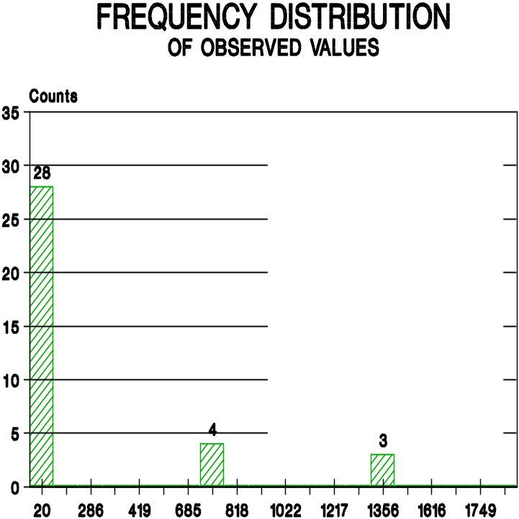
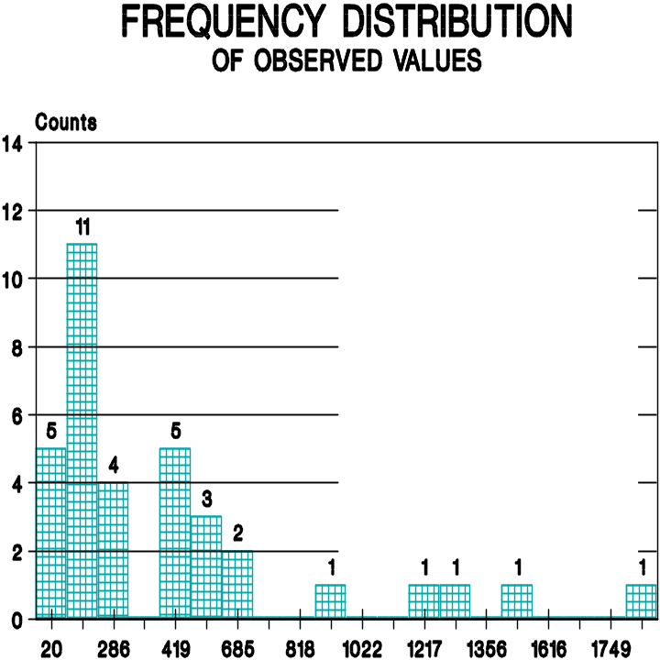
Example 15.1
too few classes
too many classes
Chapter 15
Notes:
Usually the data is plotted as a histogram.

Slide 7
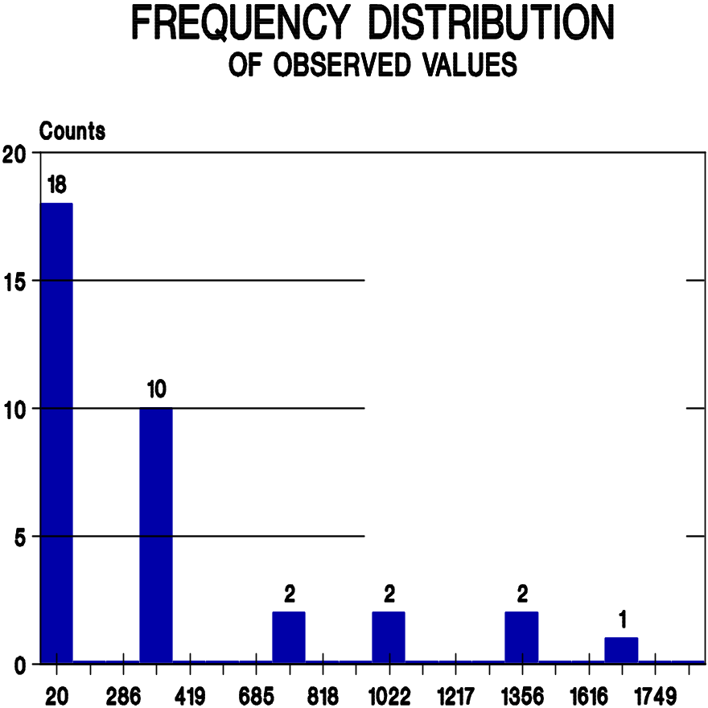
Example 15.1
just right!
Chapter 15
Notes:
Usually the data is plotted as a histogram.

Slide 8
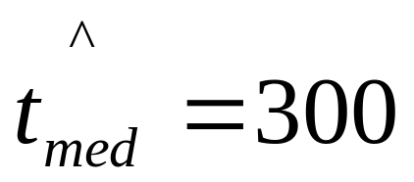
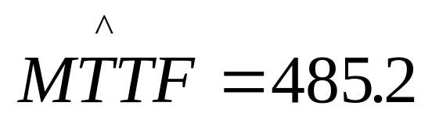
Descriptive Statistics
Rank ordered data:
20 31 36 47 98
157 182 185 210 210
214 221 246 247 279
284 289 300 400 401
428 438 442 467 499
552 553 597 767 796
1024 1297 1476 1563 2025
supports exponential
s = 469.8
s² = (20² + 31² + ... + 2025² - 35 x 485.2²)/34 = 220,712.3
Chapter 15
Notes:
Descriptive statistics include sample means, standard deviations, medians, etc. If the data came from an exponential distribution, we would expect the sample mean and standard deviation to be close to one another. If the data came from a symmetrical distribution such as the normal, we would expect the sample mean and median to be close to one another.

Slide 9
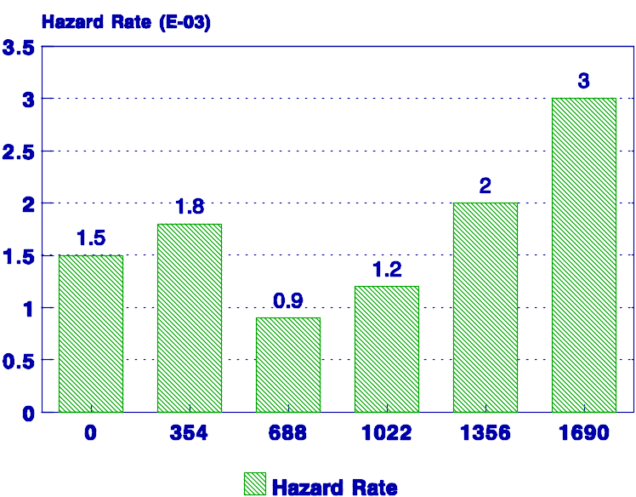
Empirical Hazard Rate Curve
Chapter 15
Notes:
Plotting the empirical hazard rate curve may tell us if the hazard rate function is DFR, CFR, or IFR. It may be inconclusive like this example.

Slide 10
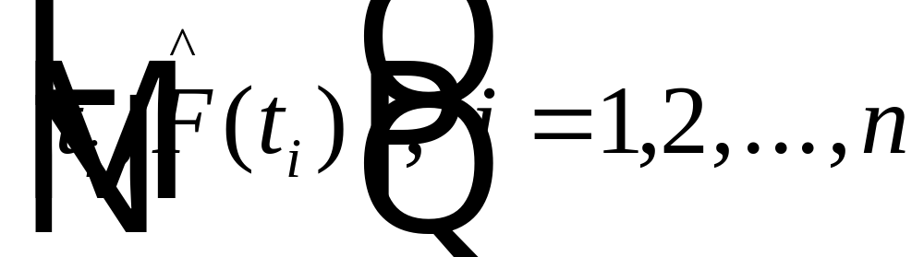
Probability Plots
plotting position
plots as a straight line on appropriate graph paper
y = a + b x
Chapter 15
Notes:
A probability plot is a graph constructed from the plotting positions. When plotted on special graph paper such as Weibull or lognormal, the plot will be an approximate straight-line if the data came from the corresponding distribution.

Slide 11
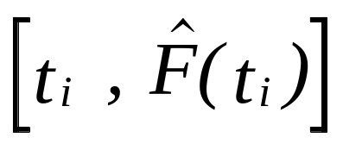
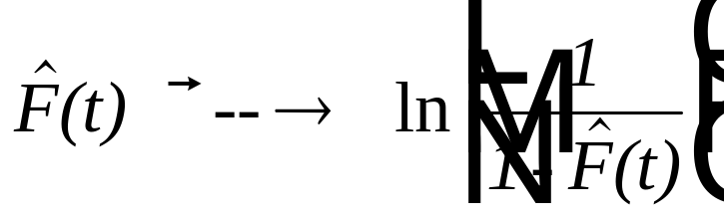
Exponential Plots
F(t) = 1 - e^{-λt} or 1 - F(t) = e^{-λt}
ln [1 - F(t)] = - λt or
- ln [1 - F(t)] = ln [1/(1-F(t))] = λt
On special graph paper, given failure times
t₁, t₂, ... , t_{n}, plot the points
vertical scale:
Chapter 15
Notes:
Probability plots for the exponential are based upon the above transformation that will create a linear graph if the data is exponential.

Slide 12
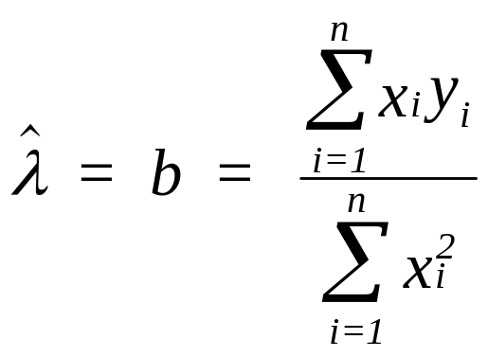
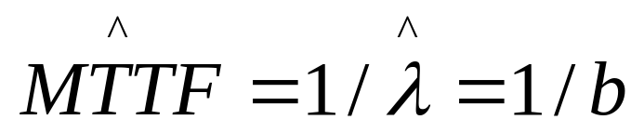
Exponential Plots - least-squares
parameter estimation: Since F(MTTF) = 1 - e⁻¹ = .632
Find the value of t which corresponds to F(t) = 0.632.
alternatively use least-square to fit a line passing through
the origin:
where y_{i} = ln {1/[1-F(t)]} and x_{i} = t_{i}.
Chapter 15
Notes:
Least-squares is used to estimate the slope of the line. For the exponential case, there is no intercept since the line goes through the origin.

Slide 13
Example 15.4
FAILURE TIME (x_{i}) F(t_{i}) y_{i} =Ln [1/(1-F(t_{i}))]
3.3 3.431373E-02 3.491616E-02
4.2 8.333334E-02 8.701131E-02
12.9 .132353 .1419703
13.8 .1813726 .2001262
14.3 .2303922 .2618741
14.8 .2794118 .3276874
18.5 .3284314 .398139
22.8 .377451 .4739329
27.1 .4264706 .5559461
29.7 .4754902 .6452911
32 .5245098 .743409
39.5 .5735295 .8522118
41.3 .622549 .9743145
41.6 .6715686 1.113427
51.1 .7205883 1.275069
61.7 .7696078 1.467972
92.2 .8186275 1.707202
106.6 .8676471 2.022284
148.8 .9166668 2.484908
198.1 .9656863 3.372211
F(t_{i}) = (i-0.3)/(n+0.4)
SLOPE - b = 01832
Estimated MTTF
= 1/b = 54.6
Index of Fit = .979
SAMPLE MTTF = 48.7
Chapter 15
Notes:
A least-squares fit of the above sample failure data provided a high index of fit that support the use of the exponential. The approximation to the median plotting position was used although other plotting positions could be used as well.

Slide 14
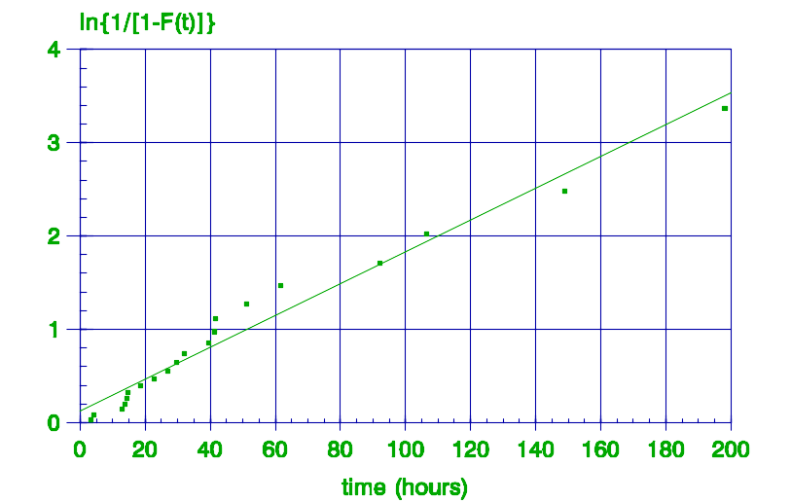
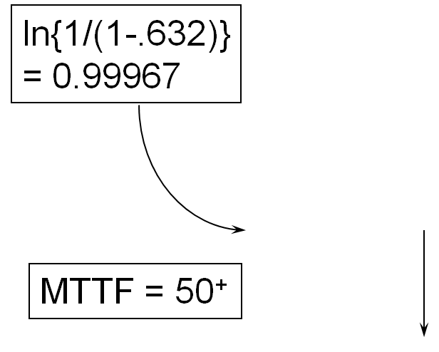
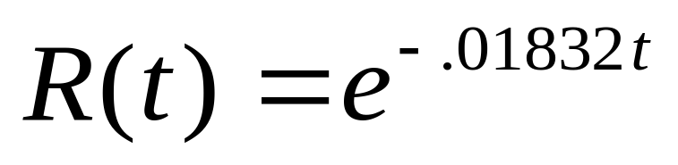
Example 15.4 – Exponential Plot
Y = .01832 X
Chapter 15
Notes:
The original data may be plotted on exponential graph paper or the transformed data may be plotted on regular graph paper.

Slide 15
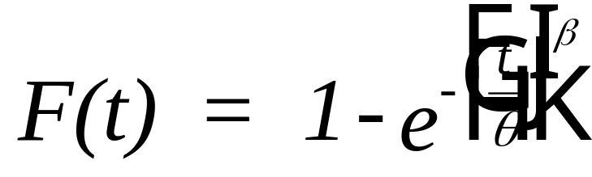
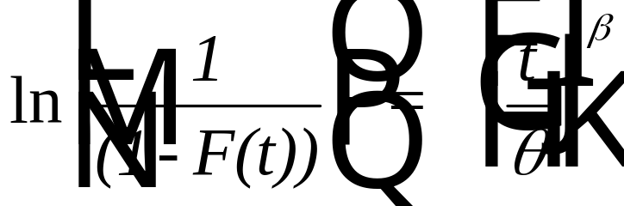
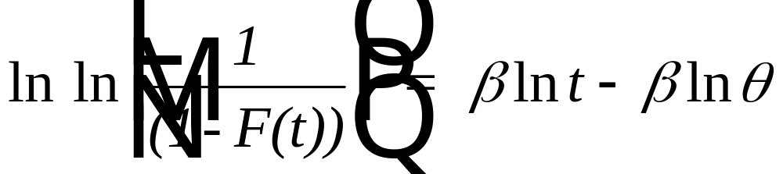
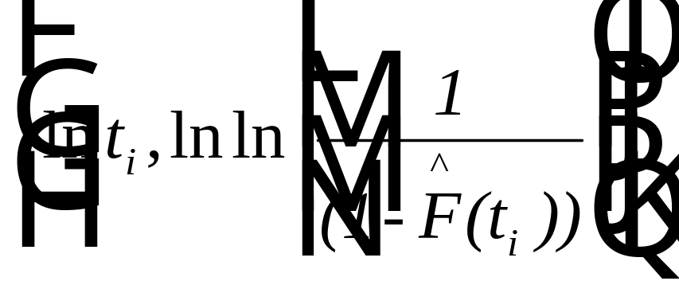
Weibull Plots
plot:
Chapter 15
Notes:
Probability plots for the Weibull are based upon the above transformation that will create a linear graph if the data is Weibull.

Slide 16
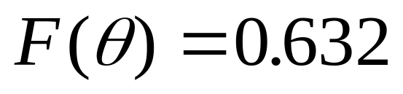
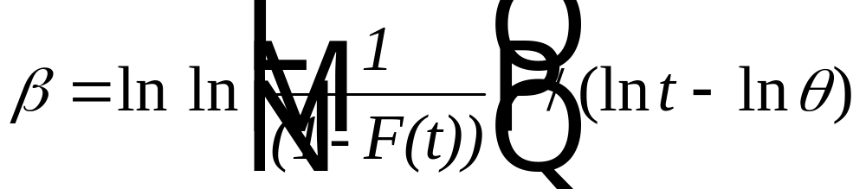
Weibull Graphs parameter estimation
Find the characteristic life from:
Find the shape parameter from the slope of the fitted line:
or solve:
find average value over several t_{i}
Chapter 15
Notes:
From a graph of Weibull failure data, the characteristic life can be estimated from the point having a failure probability of .632, and the shape parameter can be estimated from the slope of the fitted line.

Slide 17

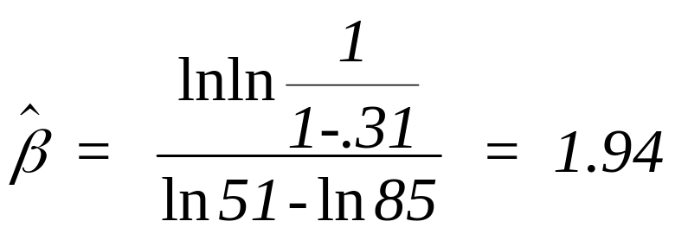
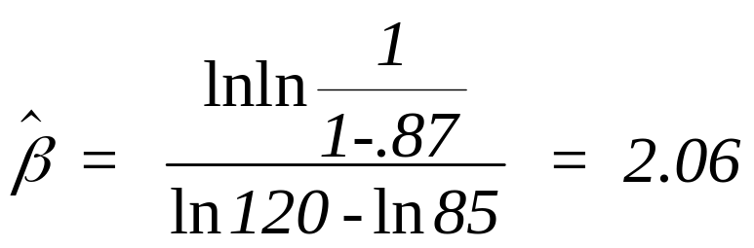

Example 15.5
i Failure Time (i-.3)/(5+.4)
1 32 hrs .13
2 51 .31
3 74 .50
4 90 .69
5 120 .87
From F(t) =.632
= 85 hr.
for i = 2:
for i = 5:
Chapter 15
Notes:
A numerical example in which the shape parameter is estimated by solving the transformed equation for beta at two of the data points then computing the average.

Slide 18
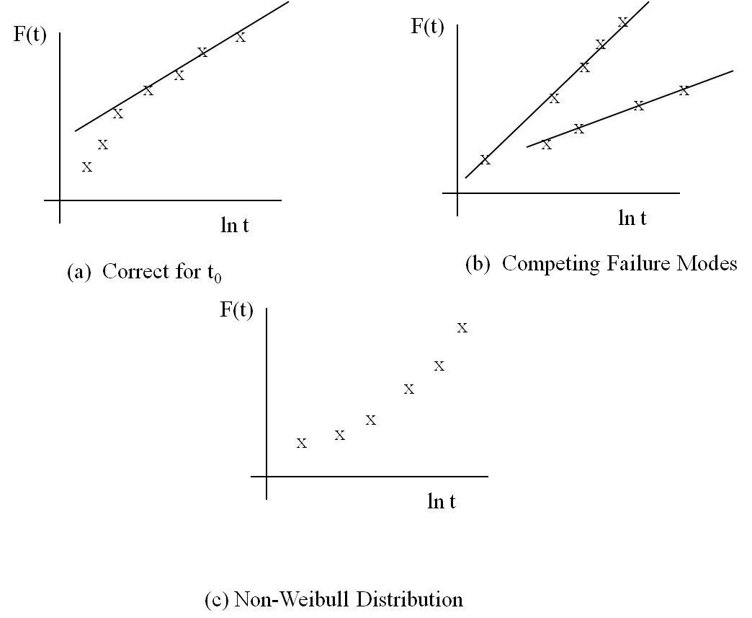
Nonlinear Weibull Plots
Chapter 15
Notes:
A plot of the Weibull may look like one of the above. In plot (a), a minimum or guaranteed life parameter should be consider. In plot (b), there may be more than one failure modes having different parameter values. In plot (c), the curve indicates that the Weibull is not a good fit.

Slide 19
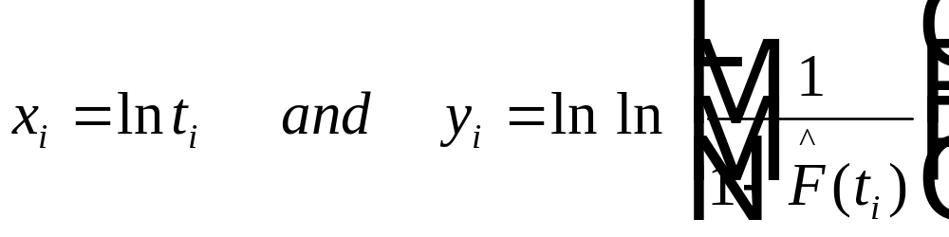
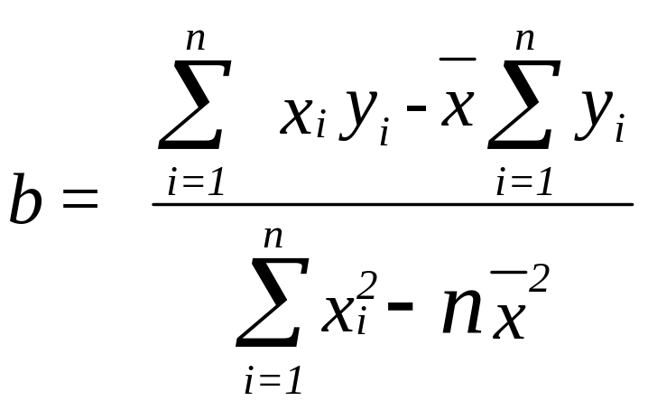
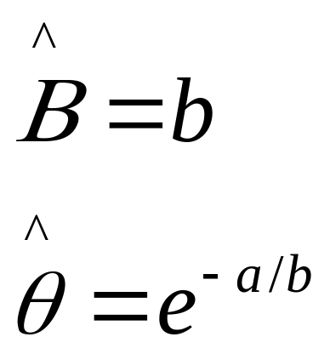
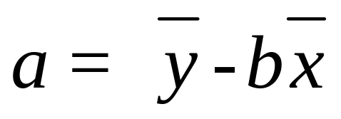
Least-Squares Approach
Chapter 15
Notes:
Least-squares can be used to estimate both the slope and the intercept of the line rather than plotting the data.

Slide 20
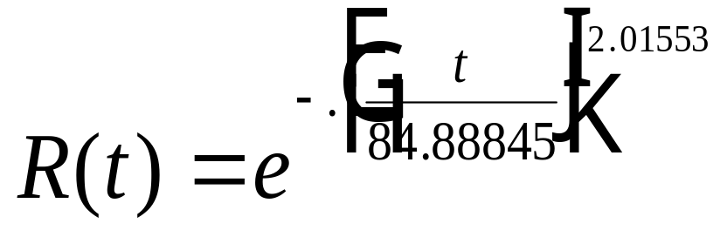
Example 15.5 (continued)
FAILURE TIME F(t_{i}) =(i-0.3)/(n+0.4) ln ln[1/(1-F(t_{i}))]
32 .1296296 -1.974459
51 .3148148 -.9726862
74 .5 -.3665129
90 .6851852 .1447674
120 .8703704 .7144555
INTERCEPT - a -8.951651
SLOPE - b 2.01553
ESTIMATED BETA 2.01553
ESTIMATED THETA 84.88845
Index-of-Fit (R) .9986
Chapter 15
Notes:
An example based upon a least-squares estimate of the parameters.

Slide 21
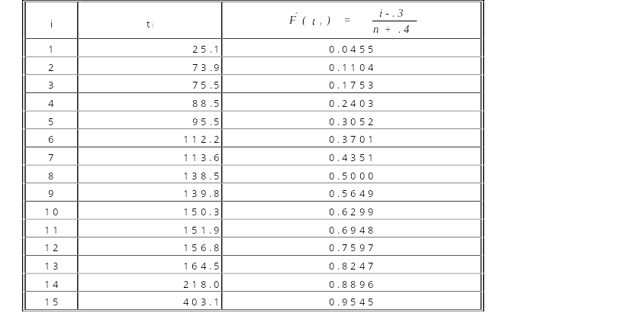
Example 15.6
y_{i} = ln ln [1/(1-F(t_{i})) ]
-3.067874
2.145824
-1.646281
-1.291789
-1.010262
-0.7716678
-0.5602884
-0.3665131
-0.1836104
-6.117305E-03
0.1712648
0.3548976
0.5545261
0.7901556
1.128508
Chapter 15
Notes:
A second example of fitting a Weibull curve to complete failure data.

Slide 22
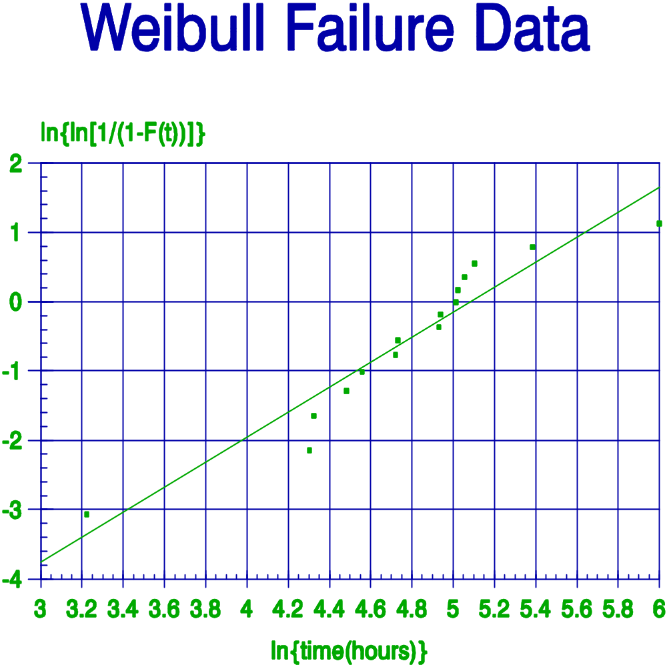
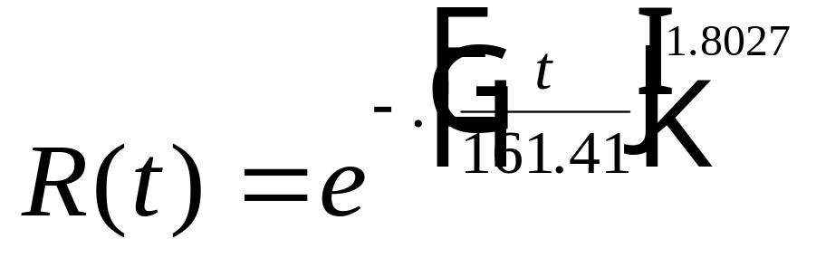
Example 15.6
INTERCEPT - a -9.1649
SLOPE - b 1.8027
Estimated BETA (ß) 1.8027
Estimated THETA (θ) 161.41
Index of Fit .9545
Chapter 15
Notes:
A plot of the transformed data on ordinary graph paper.

Slide 23
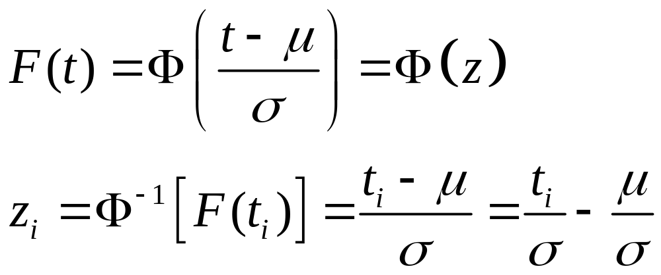
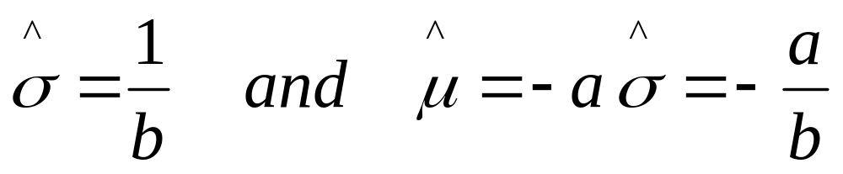
Normal Plots
set: x_{i} = t_{i} and y_{i} = z_{i} and apply the L-S fomulae
Chapter 15
Notes:
To linearize the normal distribution, the transformation requires converting the estimate of the cumulative probability to the corresponding z value. Failure time, t, and z are then linearly related. From the slope and intercept of the fitted line, sigma and mu can be estimated.

Slide 24

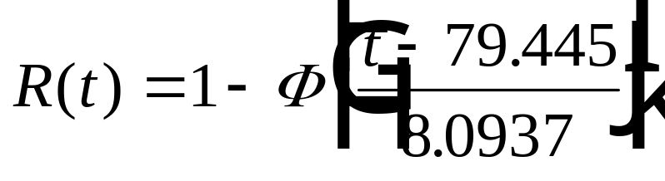
Example
I x_{i} = t_{i} F(t_{i}) y_{i} = z_{i}
1 68.0 0.0343 -1.8211
2 69.6 0.0833 -1.3832
3 71.1 0.1324 -1.1151
4 71.4 0.1814 -0.9100
5 74.3 0.2304 -0.7375
6 74.6 0.2794 -0.5846
7 75.5 0.3284 -0.4443
8 77.6 0.3775 -0.3121
9 77.8 0.4265 -0.1853
10 78.0 0.4755 -0.0615
11 78.2 0.5245 0.0615
12 80.2 0.5735 0.1853
13 80.3 0.6225 0.3121
14 81.9 0.6716 0.4443
15 83.0 0.7206 0.5846
16 85.6 0.7696 0.7375
17 87.4 0.8186 0.9100
18 87.7 0.8676 1.1151
19 88.4 0.9167 1.3832
20 98.3 0.9657 1.8211
(i - 0.3) / (20 + 0.4)
INTERCEPT - a = -9.81565
SLOPE - b = 0.123553
Estimated SIGMA (σ) = 1/b = 8.0937
Estimated MEAN = -a/b = 79.445
Index of Fit = R = 0.979
Chapter 15
Notes:
An example of fitting the normal distribution. Exercise the course software using this set of failure data and compare results.

Slide 25
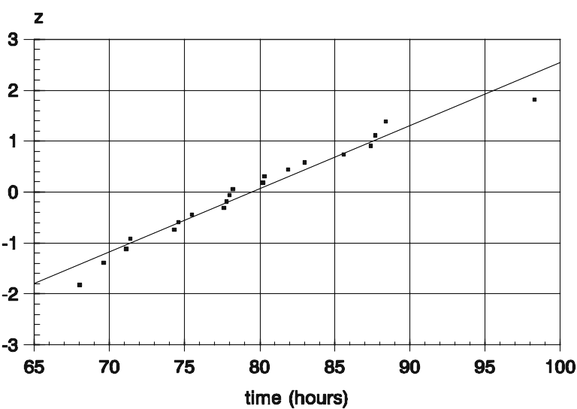
Example – Normal Probability Plot
Y = .123553 X - 9.81565
Chapter 15
Notes:
A normal plot of failure times versus the corresponding z value.

Slide 26
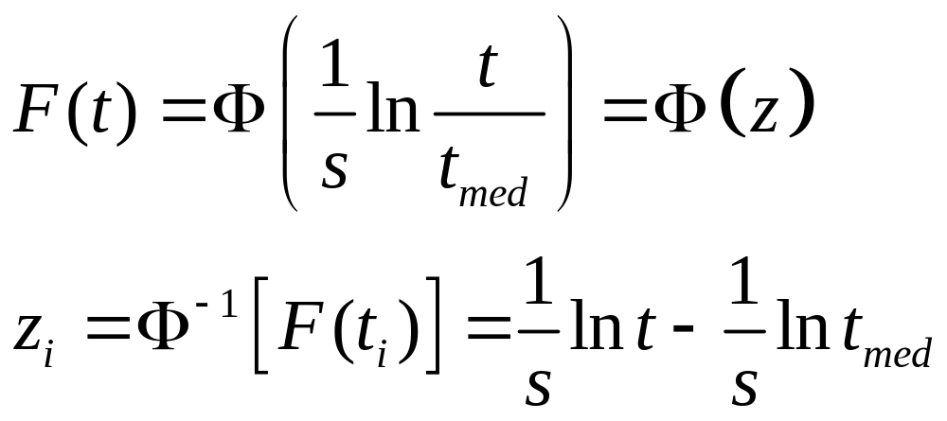
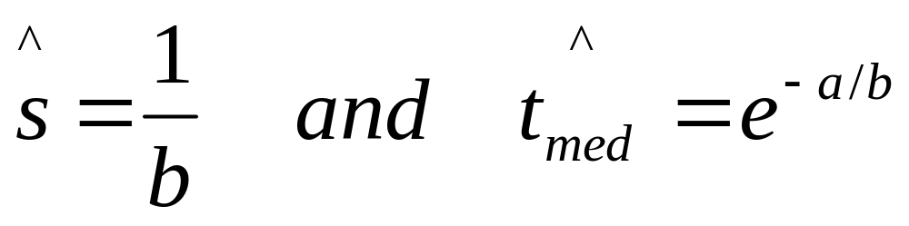
Lognormal Plots
set: x_{i} = ln t_{i} and y_{i} = z_{i} and apply the L-S fomulae
Chapter 15
Notes:
The lognormal is similar to the normal except z is linear in the log of the failure times.

Slide 27

Example
Repair times (in min.) of a mechanical pump are believed to
follow a lognormal distribution.
i t_{i} F(t_{i}) z_{i}
1 44.0 0.0276 -1.9173
2 47.1 0.0669 -1.4993
3 53.4 0.1063 -1.2465
4 59.8 0.1457 -1.0551
5 61.5 0.1850 -0.8965
6 77.0 0.2244 -0.7574
7 78.7 0.2638 -0.6317
8 84.8 0.3031 -0.5155
9 99.6 0.3425 -0.4057
10 100.8 0.3819 -0.3005
11 102.4 0.4213 -0.1986
12 104.6 0.4606 -0.0989
13 112.3 0.5000 0.0000
14 122.1 0.5394 0.0990
15 122.5 0.5787 0.1986
i t_{i} F(t_{i}) z_{i}
16 138.8 0.6181 0.3005
17 151.3 0.6575 0.4057
18 151.3 0.6969 0.5155
19 151.9 0.7362 0.6317
20 186.2 0.7756 0.7574
21 213.5 0.8150 0.8965
22 218.2 0.8543 1.0551
23 222.8 0.8937 1.2461
24 230.1 0.9331 1.4993
25 498.4 0.9724 1.9173
(i - 0.3) / (25 + 0.4)
Chapter 15
Notes:
A lognormal example using repair data.

Slide 28
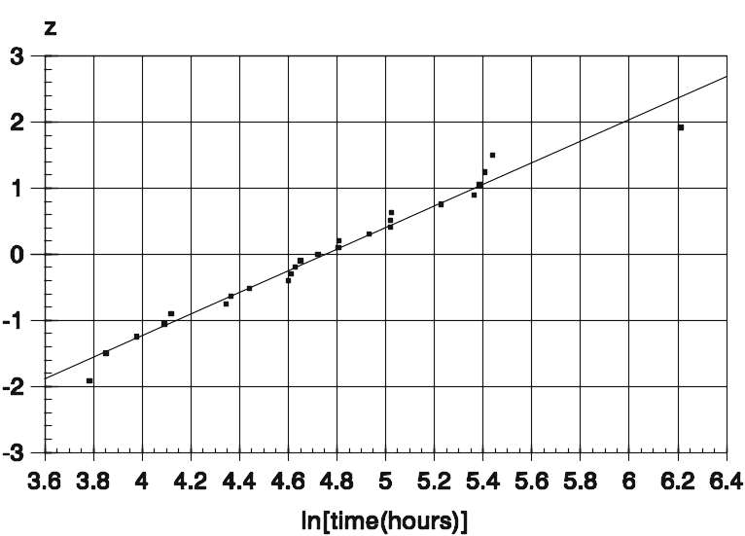
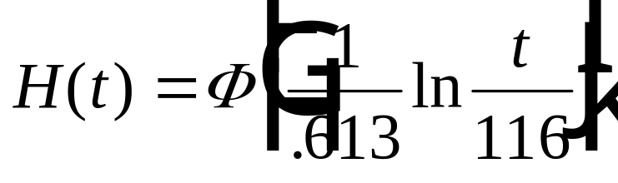
Example – Lognormal Probability
INTERCEPT - a = -7.755
SLOPE - b = 1.631
Estimated s = 1/b = 0.613
Estimated T_{MED} = e^{-sa} = 116.0
Index of Fit = 0.986
Y = 1.631X - 7.755
Chapter 15
Notes:
A plot of the log of the failure times versus the z value.

Slide 29
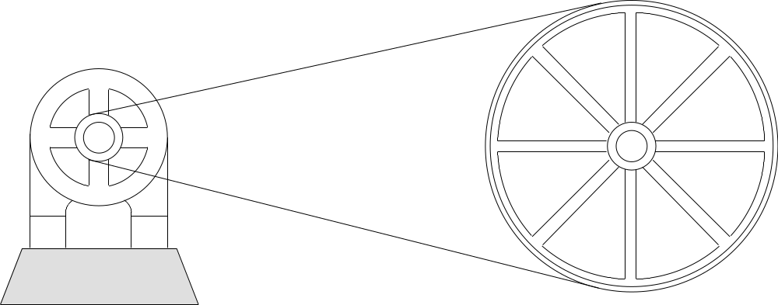
Multiply Censored Plots
Thirty motors are placed on accelerated test with failures
occurring at the following cycle times. A cycle consists of
a motor starting up to its maximum number of revolutions
per minute then shutting down until it has come to a
complete stop. Censored units resulted from motors
removed from test to satisfy other demands.
Chapter 15
Notes:
When multiply censoring is present, the plotting positions are adjusted using one of the techniques discussed in Chapter 12.

Slide 30
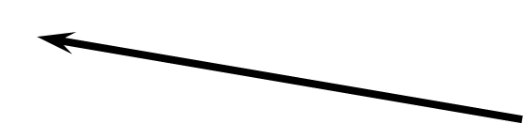
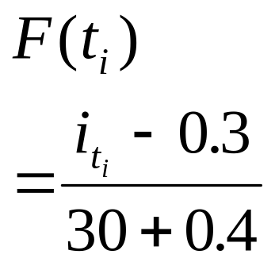

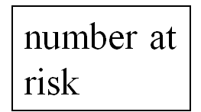
Time Adj Rank (i) F(t_{i}) y = ln [1/(1-F)] ln y
141 1 .023 .0233 -3.735
391 2 .056 .0575 -2.855
399 3 .089 .0930 -2.375
410+
463 4.04 .123 .1311 -2.031
465 5.07 .157 .1708 -1.767
497 6.11 .191 .2121 -1.550
501+
559 7.19 .227 .2571 -1.358
563 8.27 .262 .3043 -1.190
579 9.36 .298 .3537 -1.039
580+
586 10.50 .336 .4086 -.8950
616 11.64 .373 .4666 -.7622
683 12.77 .410 .5282 -.6382
707 13.91 .448 .5939 -.5211
713 15.05 .485 .6641 -.4092
742+
755+
764 16.38 .529 .7529 -.2838
Multiply Censored Plots
fit exponential
fit Weibull
Chapter 15
Notes:
Using the rank adjustment method, the cumulative failure probabilities are found. These are then used along with least-squares to fit a distribution. The points to be fit are the failure times, t, and the adjusted F(t).

Slide 31
EXAMPLE 15.10
A newly manufactured diesel engine is experiencing frequent failures as a result of either the ignition system failing (failure mode A) or the fuel injection system failing (failure mode B). Tracking failures under a one-year warranty, the following failure times were recorded in days since beginning operation for the first 40 units sold:
Unit Number | 12 | 3 | 22 | 9 | 31 | 38 | 5 | 8 | 27 | 18 | 23 | 19 | 32 | 13 | 30 | 36 | 24
Failure time | 2 | 8 | 15 | 30 | 35 | 61 | 123 | 123 | 132 | 184 | 186 | 202 | 218 | 232 | 269 | 297 | 333
Failure mode | A | A | A | A | A | B | A | B | B | A | A | A | A | B | B | B | A
Chapter 15

Slide 32

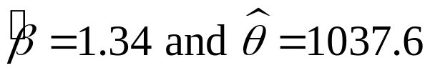
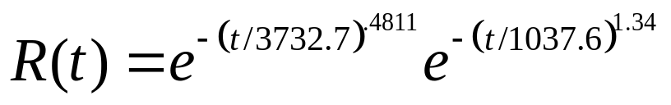
EXAMPLE 15.10
i | t_{i} | F(t_{i}) | i | t_{i} | F(t_{i})
0 | 0 | 0.0000 | 10 | 184 | 0.1737
1 | 2 | 0.0244 | 11 | 186 | 0.2003
2 | 8 | 0.0488 | 12 | 202 | 0.2270
3 | 15 | 0.0732 | 13 | 218 | 0.2537
4 | 30 | 0.0976 | 14 | 232.0⁺
5 | 35 | 0.1220 | 15 | 269.0⁺
6 | 61.0⁺ |  | 16 | 297.0⁺
7 | 123 | 0.1470 | 17 | 333 | 0.2835
8 | 123.0⁺ |  | 18-40 | 365.0⁺
9 | 132.0⁺
For Weibull distribution -
Least-squares fit:
Failure Mode A:
Failure Mode B:
Chapter 15

Slide 33
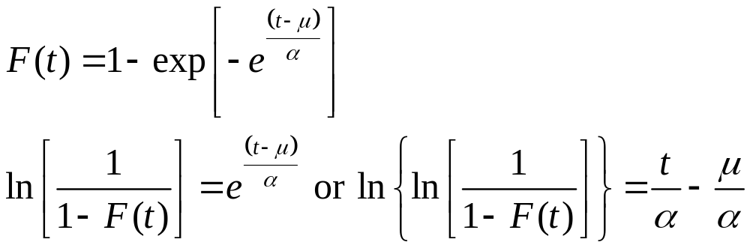
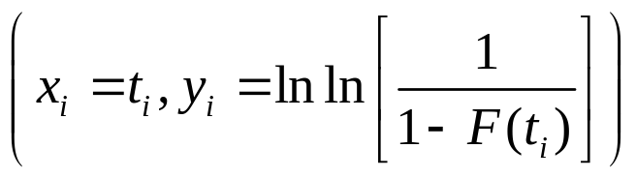
Minimum Extreme Value Distribution
Therefore plot x_{i} and y_{i} and fit the line y = a + bx.
The least-squares parameter estimates are α = 1/b and μ = -aα.
Chapter 15

